Slide 1
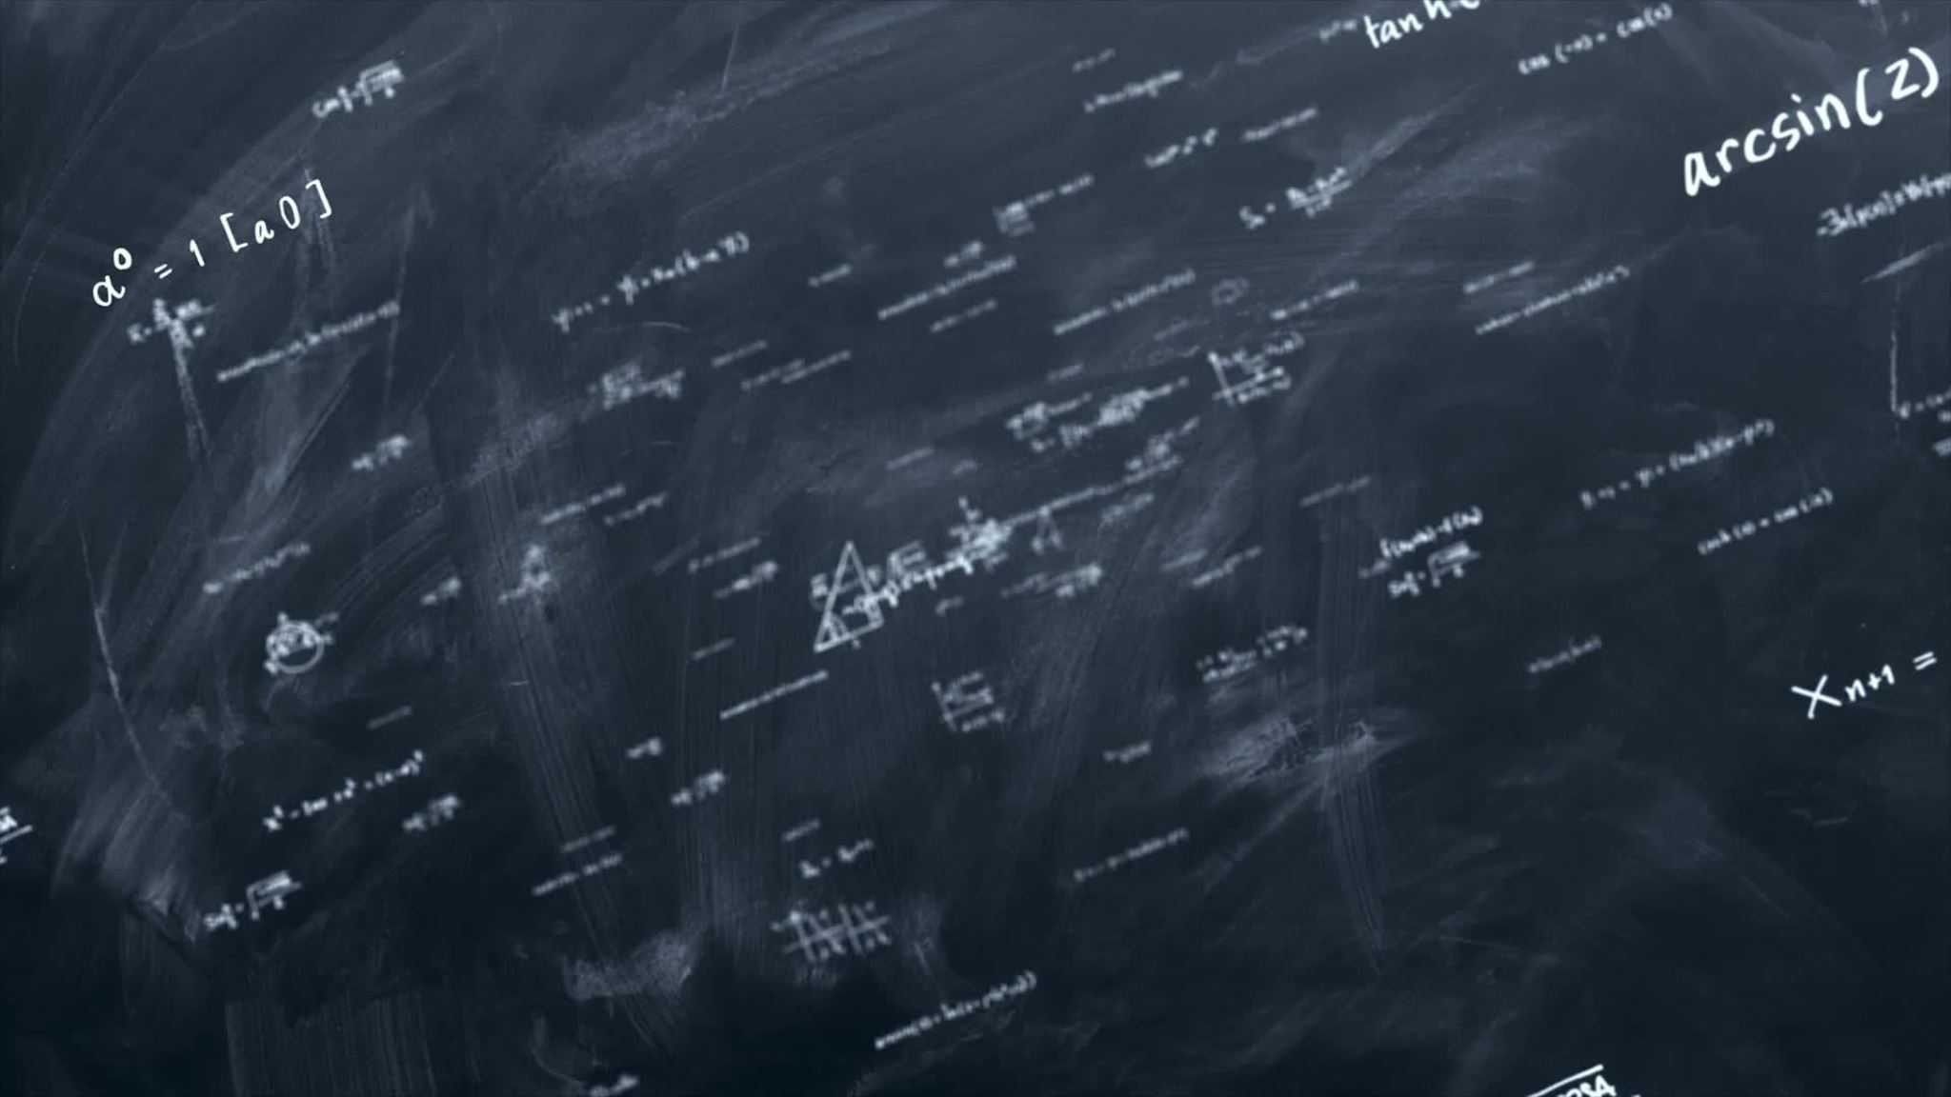
Image Segmentation

Slide 2
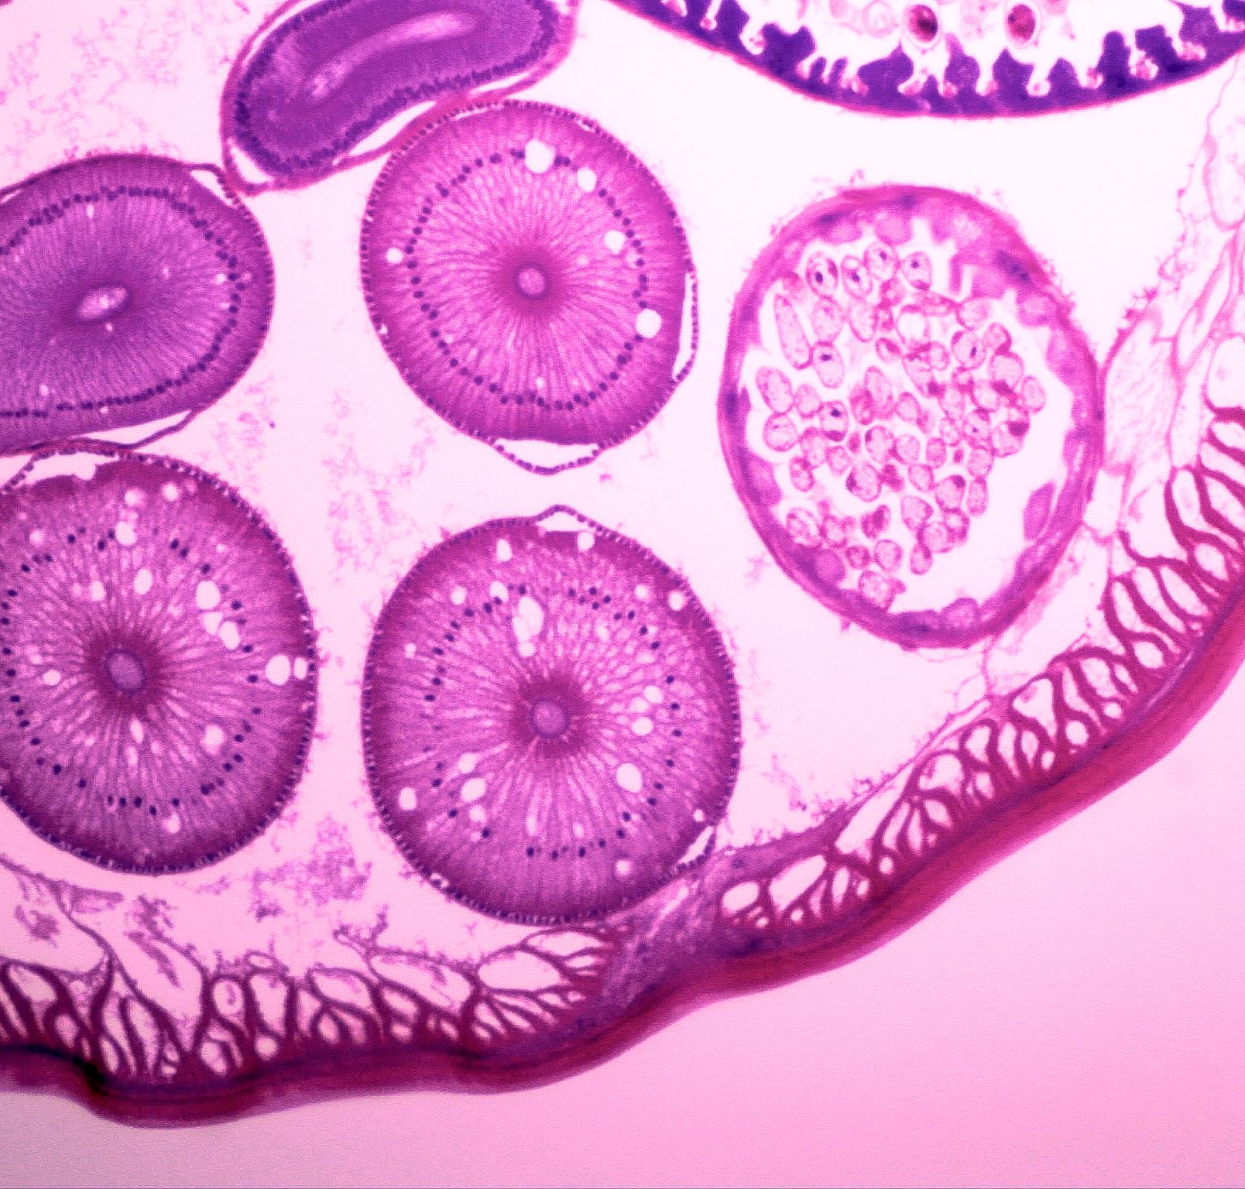
Applications of Image Segmentation in Medical
Tumor detection and delineation
Organ and tissue segmentation
Vascular structure analysis
Surgical planning and navigation

Slide 3
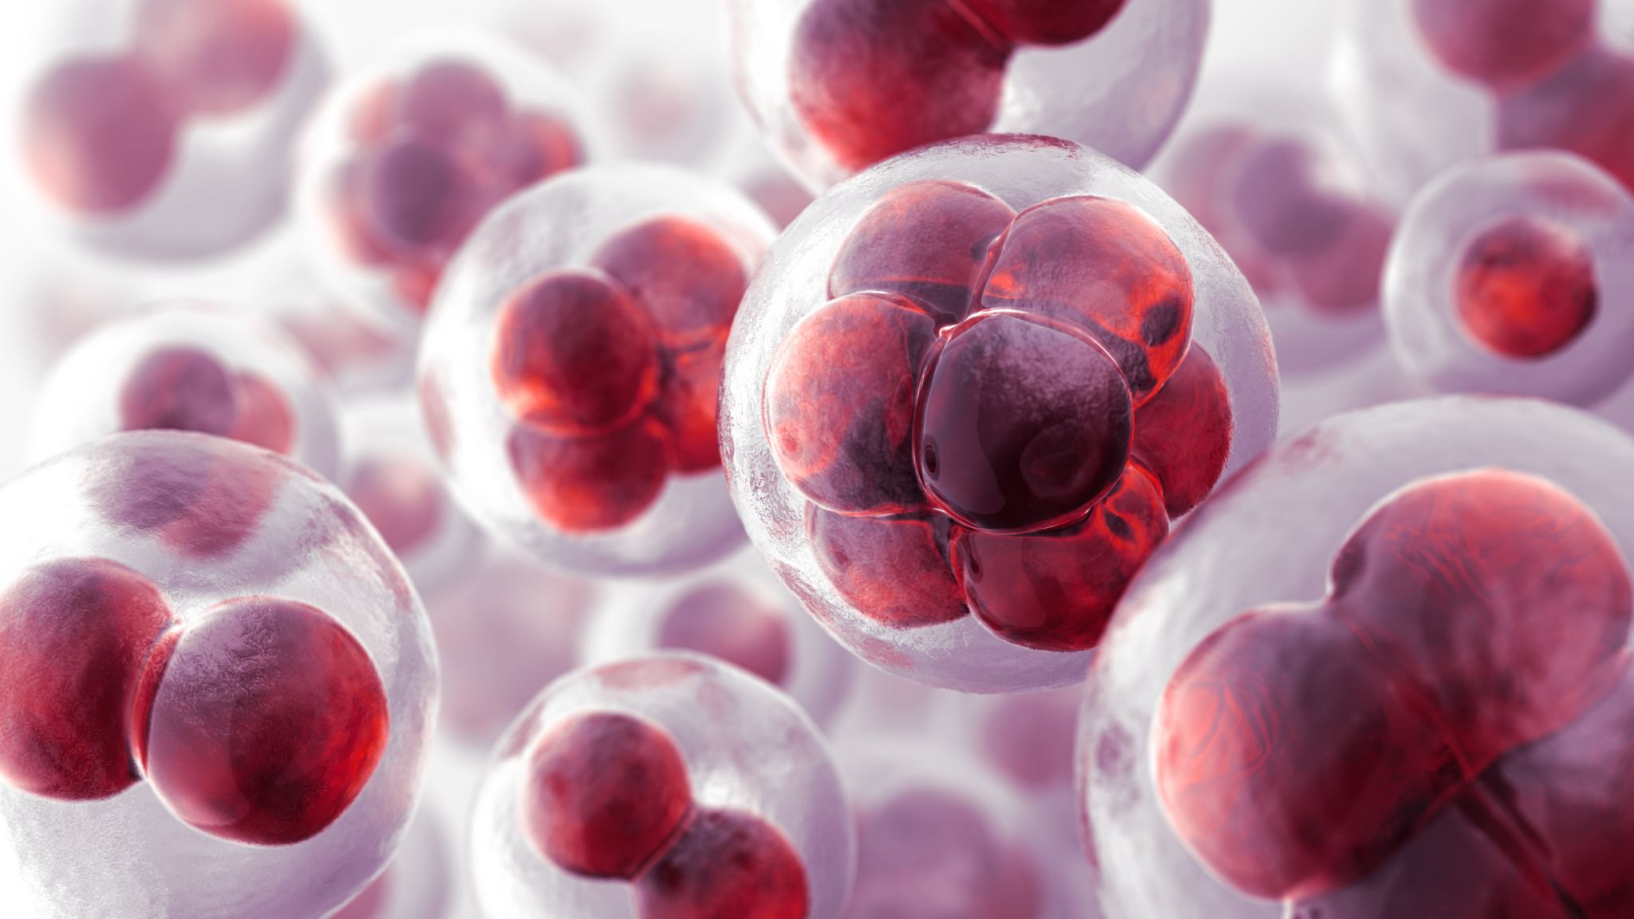
Tumor detection and delineation

Slide 4
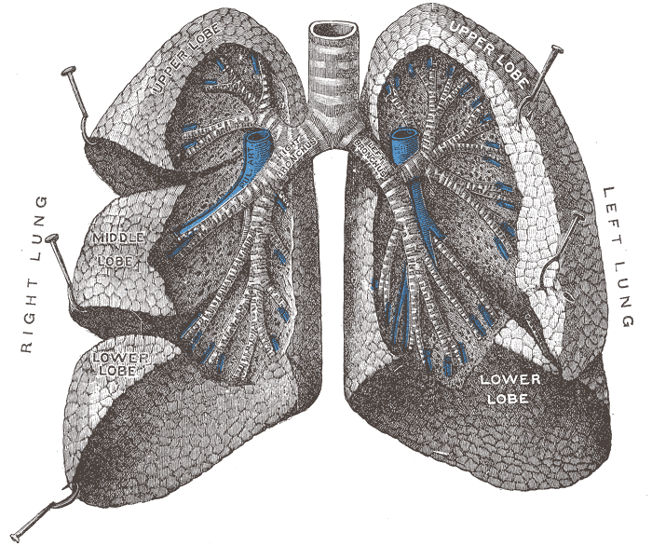
Organ segmentation and tissue segmentation
This Photo by Unknown author is licensed under CC BY-SA.

Slide 5
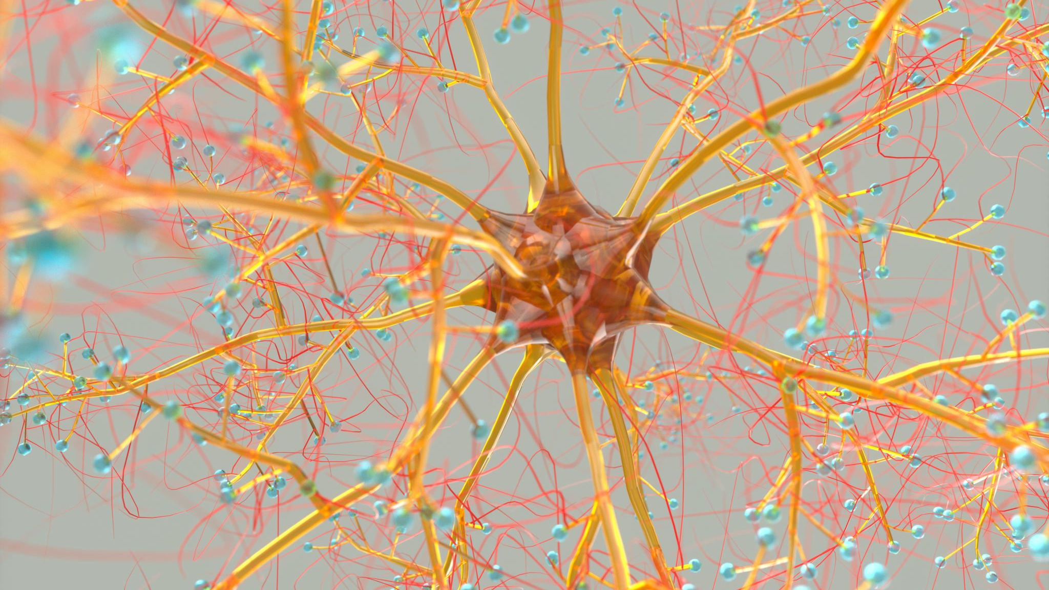
Vascular structure analysis

Slide 6

Surgical planning and navigation

Slide 7
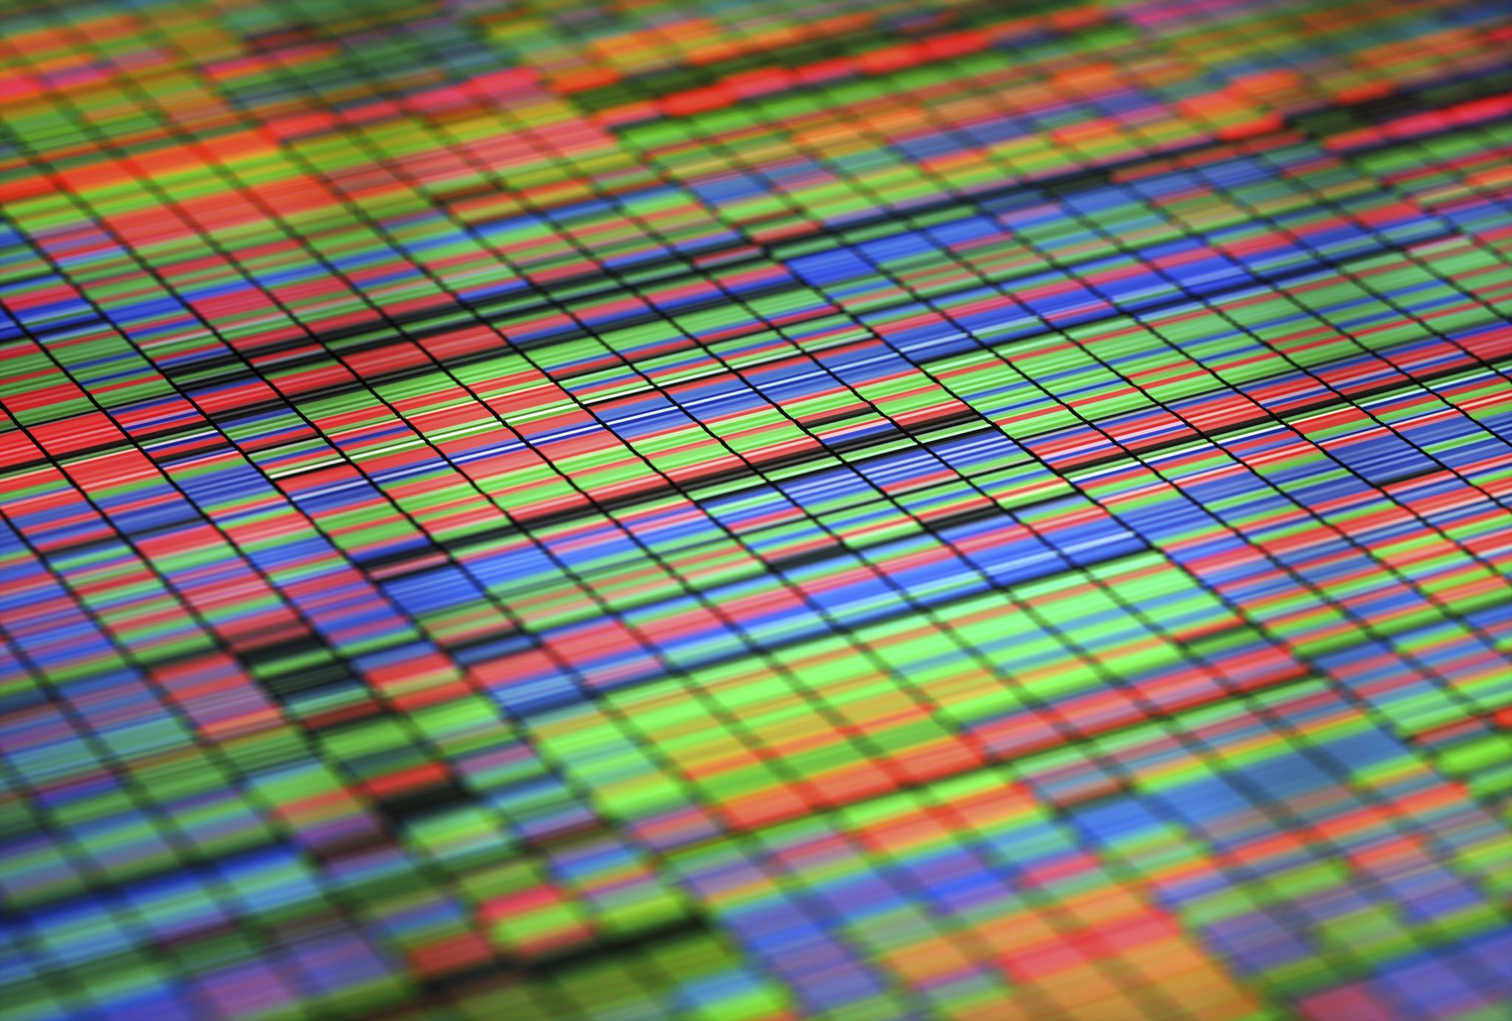
Types of Image Segmentation
Pixel-based segmentation
Region-based segmentation
Semantic segmentation
Instance segmentation

Slide 8

Pixel-based segmentation
Pixel-based segmentation is a technique where each pixel in an image is assigned a label or category, typically representing different classes or objects.
Image Labeling
Semantic Segmentation
Applications in Medicine
Training Data
Notes:
Image Labeling:
Assigning a specific label to each pixel based on its characteristics and context within the image.
Semantic Segmentation:
Differentiating objects or regions in an image based on their semantic meaning.
Example: Distinguishing between organs in a medical image.
Applications in Medicine:
Identifying and delineating tumors, lesions, and other abnormalities.
Providing precise organ and tissue boundaries for medical diagnosis and treatment planning.
Training Data:
Pixel-based segmentation requires a large amount of annotated data for training machine learning models.
The dataset should include images with corresponding pixel-level labels.

Slide 9
DL for Pixel Based Segmentation
U-Net: A popular architecture for semantic segmentation, especially in medical imaging.
Fully Convolutional Networks (FCN): Designed for pixel-wise classification tasks.
DeepLab: Utilizes dilated convolutions for improved segmentation performance.

Slide 10
Challenges: Pixel Based Segmentation
Pixel Ambiguity: Pixels on object boundaries may belong to multiple classes.
Computational Intensity: Pixel-based segmentation can be computationally demanding, especially for high-resolution medical images.

Slide 11

Evaluation Metrics: Pixel Based Segmentation
Intersection over Union (IoU): Measures the overlap between predicted and ground truth regions.
Dice Coefficient: Similar to IoU, commonly used for segmentation evaluation.

Slide 12

Applications: Pixel Based Segmentation
Pixel-based segmentation has potential applications in real-time medical image analysis, enabling prompt decision-making in critical situations.
Polyps Segmentation
Cancer region
Lesion detection

Slide 13
Limitation: Pixel Based Segmentation
Sensitivity to image noise and artifacts.
Difficulty in handling variations in object shapes and sizes.

Slide 14
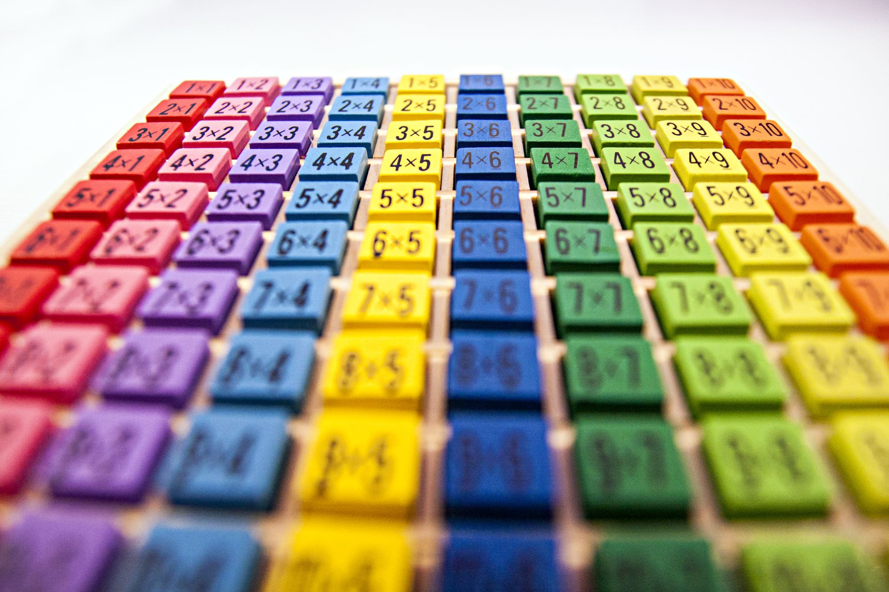
Region-based segmentation
Region-based segmentation involves grouping pixels into meaningful regions based on their shared properties, such as color, texture, or intensity.

Slide 15
Image Partitioning
The image is partitioned into homogeneous regions, where pixels within a region share common features.
Homogeneity Criteria:
Regions are defined based on criteria like color similarity, intensity homogeneity, or texture coherence.
These criteria are used to ensure that pixels within a region are more similar to each other than to pixels in neighboring regions.
Seed Point Initialization:
Many region-based segmentation algorithms start with seed points and grow regions by incorporating neighboring pixels that meet certain similarity criteria.

Slide 16
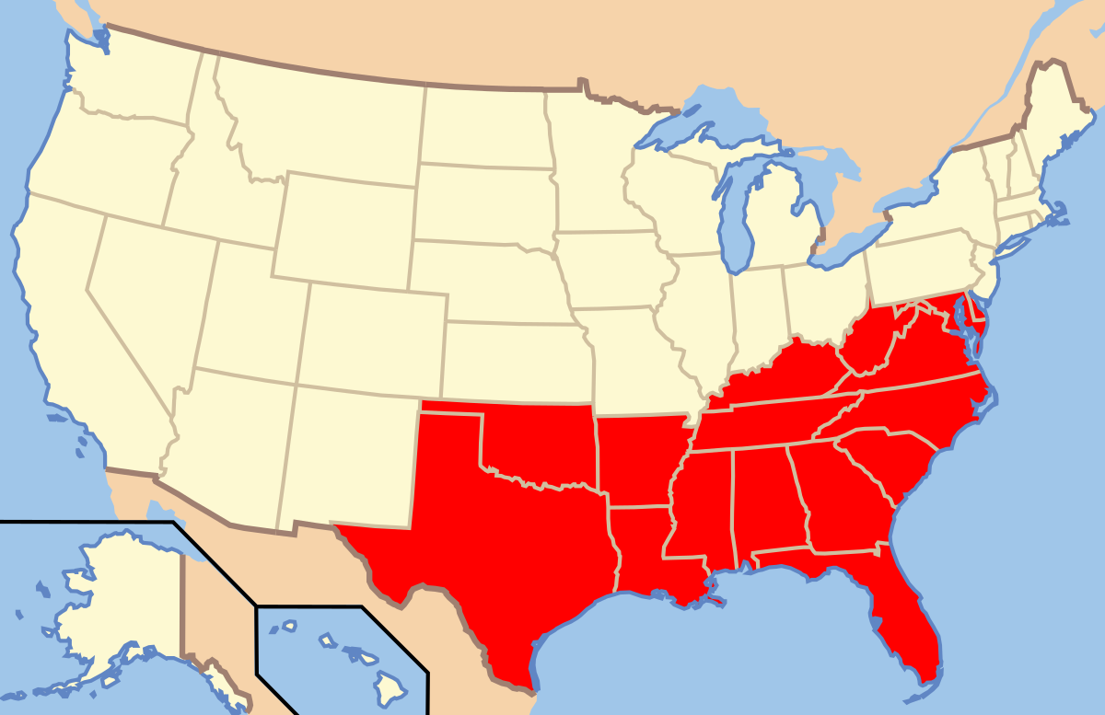
Algorithms: Region-based segmentation
Region Growing
Region Merging
Watershed Algorithm
Graph-based Segmentation
Mean Shift
Felzenszwalb's Algorithm
Selective Search
GrabCut

Slide 17

Pseudo Code
def segmentation_train (Image, mask)
def segmentation (image):
Return mask

Slide 18
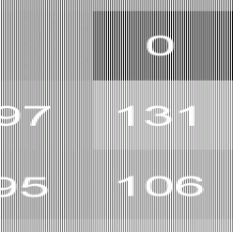
Region Growing
Start with seed points and grow regions by adding neighboring pixels that satisfy a certain similarity criterion.
This Photo by Unknown author is licensed under CC BY-NC.

Slide 19
Region Growing...
def region_growing(image, seed_point, threshold):
region = empty_set()
neighbors = get_neighbors(seed_point)
while neighbors is not empty:
current_point = neighbors.pop()
if similarity(image[seed_point], image[current_point]) < threshold:
region.add(current_point)
neighbors.union(get_neighbors(current_point))
return region

Slide 20

Region Growing...
Usage:
Useful for segmenting homogeneous regions based on pixel similarity.
Often applied to medical imaging and satellite imagery.
Pros:
Simple and intuitive.
Effective for certain types of images with well-defined regions.
Cons:
Sensitive to the choice of seed points and threshold.
Prone to over segmentation or under segmentation.

Slide 21
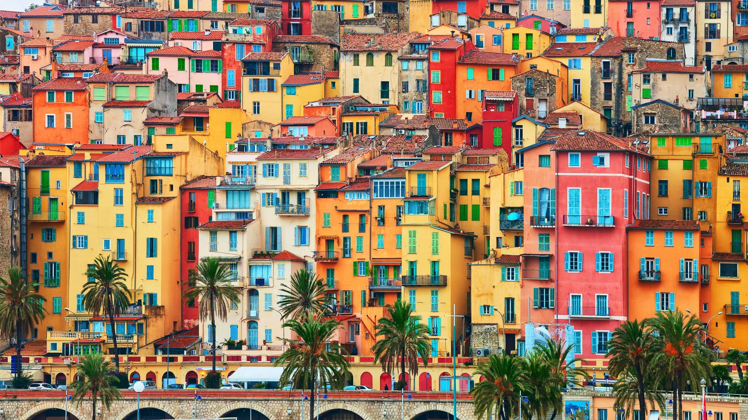
Region Merging
Start with small regions and iteratively merge adjacent regions based on a similarity criterion.

Slide 22
Region Merging...
def region_merging(image, similarity_threshold):
regions = initialize_regions(image)
while not converged(regions, similarity_threshold):
merge_regions(regions)
return regions

Slide 23
Region Merging...
Usage:
Suitable for segmenting images with textured regions.
Used in computer vision tasks such as object recognition.
Pros:
Adaptable to various image characteristics.
Provides flexibility in merging strategy.
Cons:
Sensitive to initial segmentation.
Computationally intensive for large datasets.

Slide 24

Watershed Algorithm
View the image as a topographic surface where the intensity values represent the elevation. Watershed lines separate catchment basins, and these basins correspond to the segmented regions.

Slide 25
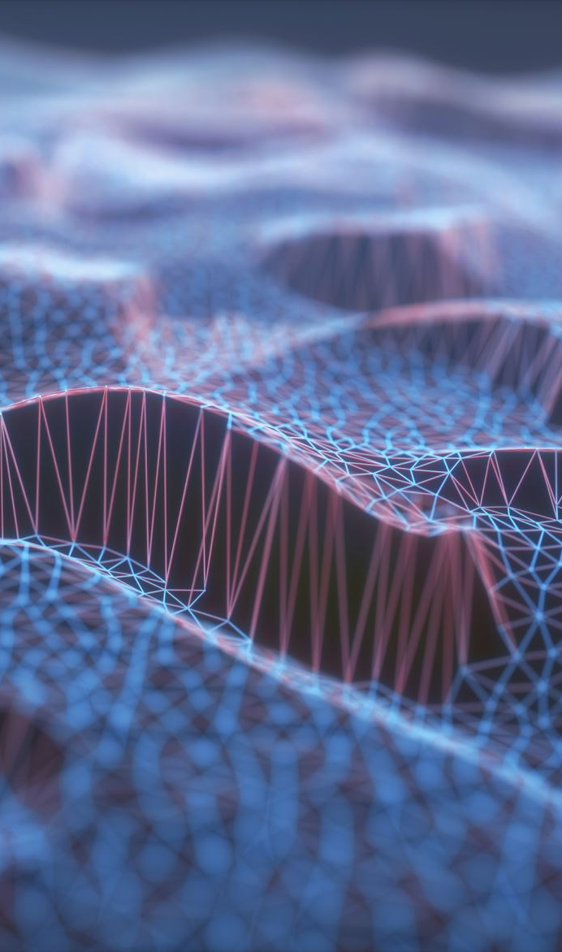
Watershed Algorithm
Gradient Computation
Marker Selection
Flood Simulation
Watershed Lines
Labeling Segments
Notes:
Gradient Computation:
Compute the gradient of the image to highlight the edges. This is typically done by applying a gradient filter or other edge detection methods.
Marker Selection:
Identify markers, which are seed points used to initiate the flooding process. Markers can be chosen based on the image's characteristics or provided by external information. Commonly, markers are placed at local minima in the gradient image.
Flood Simulation:
Treat the intensity values as elevations in a landscape. Imagine each pixel as a point on the landscape, and the intensity as its elevation. Start flooding the landscape from the markers, allowing water to flow until it reaches a point where water from different markers converges.
Watershed Lines:
As the flooding process continues, watershed lines are formed where the flooded areas meet. These lines separate different catchment basins.
Labeling Segments:
Label each catchment basin with a unique identifier, effectively segmenting the image into regions.

Slide 26
Watershed Algorithm...
def watershed_algorithm(image):
markers = find_markers(image)
watershed_lines = apply_watershed(image, markers)
segmented_image = label_segments(watershed_lines)
return segmented_image

Slide 27
Watershed Algorithm...
Usage:
Effective for segmenting images with well-defined boundaries.
Applied in medical image analysis and object recognition.
Pros:
Captures hierarchical relationships between regions.
Robust to noise.
Cons:
Prone to over segmentation.
Sensitivity to noise may lead to unwanted segmentation.

Slide 28
Graph-based Segmentation
Represent the image as a graph, where nodes correspond to pixels and edges represent the relationships between pixels. Use graph algorithms to identify meaningful regions.

Slide 29
Graph-based Segmentation...
def graph_based_segmentation(image):
graph = build_graph(image)
segments = apply_algorithm_on_graph(graph)
return segments

Slide 30
Graph-based Segmentation...
Usage:
Suitable for complex images with irregular boundaries.
Applied in image and video segmentation tasks.
Pros:
Flexibility in defining graph structure.
Can capture long-range dependencies.
Cons:
Computationally expensive.
Sensitivity to parameter settings.

Slide 31

Mean Shift
Perform a density estimation in the feature space, and shift points towards the mode of the estimated density to find clusters.

Slide 32
Mean Shift...
Initialization:
Select data points as initial cluster centers.
Define a window (bandwidth) around each center.
Shifting:
For each data point, calculate the mean shift vector. This vector points towards the direction of the highest increase in data density.
The mean shift vector is computed by considering the weighted average of the data points within the window, where closer points have higher weights.
Update:
Move the cluster centers to the new positions determined by the mean shift vectors.
Repeat the shifting process iteratively until convergence.
Convergence:
Convergence is typically reached when the mean shift vectors become very small or fall below a predefined threshold.
Clustering:
After convergence, data points close to the same cluster center are considered part of the same cluster.

Slide 33
Mean Shift...
def mean_shift(image, bandwidth):
shifted_points = initialize_points(image)
while not converged(shifted_points):
update_points(shifted_points, bandwidth)
clusters = group_points_into_clusters(shifted_points)
return clusters

Slide 34

Mean Shift...
Usage:
Effective for clustering and image segmentation.
Applied in object tracking and feature space analysis.
Pros:
No predefined cluster number required.
Robust to noise.
Cons:
Computationally expensive.
Sensitive to bandwidth parameter.

Slide 35
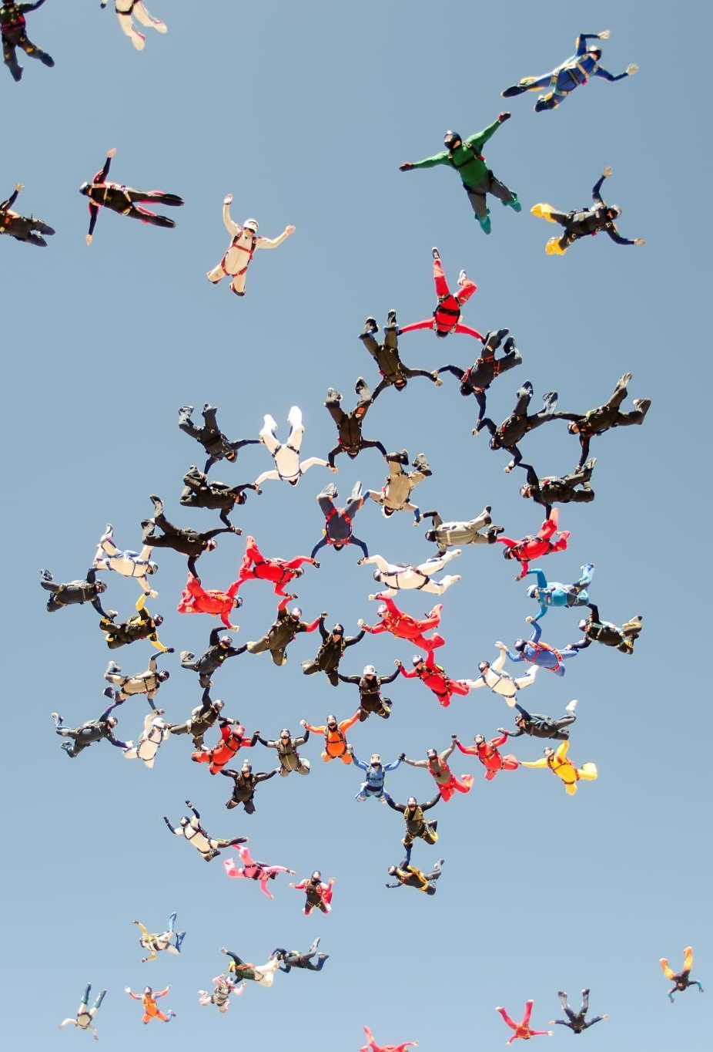
Felzenszwalb's Algorithm
Define a metric that measures the dissimilarity between pixels and merge super pixels with low dissimilarity.

Slide 36
Felzenszwalb's Algorithm...
def felzenszwalb_algorithm(image, scale, min_size):
segments = initialize_segments(image)
while not converged(segments):
merge_segments(segments, scale, min_size)
return segments

Slide 37
Felzenszwalb's Algorithm...
Usage:
Suitable for images with varying scales of regions.
Applied in object recognition and scene understanding.
Pros:
Robust to varying region sizes.
Can handle images with non-uniform texture.
Cons:
Sensitive to parameter settings.
May produce irregularly shaped segments.

Slide 38

Selective Search
Combine multiple low-level segmentation strategies to generate a diverse set of regions at different scales.

Slide 39
Selective Search...
def selective_search(image):
regions = initialize_regions(image)
strategies = [color_strategy, texture_strategy, size_strategy]
for strategy in strategies:
regions = strategy(regions)
final_segments = merge_regions(regions)
return final_segments

Slide 40
Selective Search...
Usage:
Widely used in object recognition and localization.
Applied in the selective search object proposal generation.
Pros:
Multiscale approach captures diverse regions.
Robust to variations in object appearance.
Cons:
Computationally expensive.
May generate an excessive number of proposals.

Slide 41
GrabCut
Combine graph cuts with iterative user interaction to refine image segmentation.

Slide 42
GrabCut...
def grabcut(image, mask):
segments = initialize_segments(image, mask)
for i in range(iterations):
segments = refine_segments(image, segments)
return segments

Slide 43
GrabCut...
Usage:
Widely used in interactive image segmentation.
Applied in image and video editing tasks.
Pros:
Incorporates user input for interactive segmentation.
Provides accurate results with user guidance.
Cons:
Requires user interaction.
Sensitive to the quality of user-provided seeds.

Slide 44

Applications: Region-based segmentation
Identifying and segmenting
Identifying and segmenting anatomical structures based on their inherent properties.
Extracting
Extracting regions of interest (ROIs) for further analysis in medical imaging.

Slide 45
Advantages: Region-based segmentation
Region-based segmentation is less sensitive to noise compared to pixel-based segmentation.
Well-suited for images with distinct regions of interest.

Slide 46
Challanges: Region-based segmentation
Over-Segmentation and Under-Segmentation:
Over-segmentation occurs when the algorithm creates more regions than necessary, potentially splitting meaningful objects.
Under-segmentation happens when regions are too large and fail to capture finer details.
Graph-Based Segmentation:
Represents an image as a graph, with pixels as nodes and edges connecting adjacent pixels.
Segmentation is achieved by finding optimal cuts in the graph.
Other
Choosing appropriate homogeneity criteria can be subjective and may vary based on the application.
Computationally more intensive than pixel-based segmentation.

Slide 47
Semantic segmentation

Slide 48
Instance segmentation

Slide 49
Algorithms and Techniques
Clustering Methodologies
Overview of popular segmentation algorithms (U-Net, Mask R-CNN, etc.)
Deep learning approaches for medical image segmentation
Considerations for choosing the right algorithm

Slide 50
Challenges in Medical Image Segmentation
Limited annotated data
Variability in anatomy and pathology
Real-time processing requirements
Ethical considerations

Slide 51
Limited annotated data
aa

Slide 52
Variability in anatomy and pathology

Slide 53
Real-time processing requirements

Slide 54
Ethical considerations

Slide 55
Case Studies
Highlight specific success stories in medical image segmentation
Discuss improvements in diagnosis and patient outcomes

Slide 56
Future Trends
Integration of AI and machine learning
Automation and real-time segmentation
Personalized medicine and treatment planning

Slide 57
Ethical Considerations
Patient privacy and data security
Explainability and transparency in AI algorithms
Ensuring fairness and unbiased results

